Slide 1
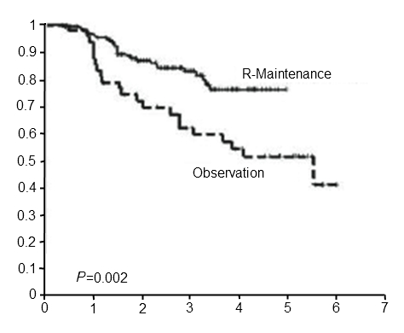
PFS in R-CVP Responders Receiving R-Maintenance vs Observation
% Survival
Time (years)
PFS=progression free survival; R-CVP=rituximab, cyclophosphamide, vincristine, prednisolone chemotherapy regimen; R-maintenance=rituximab maintenance
1803

