Slide 1
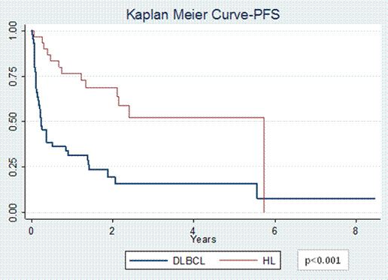
Figure 1. Progression-free Survival

